Slide 1
Data Collection

Slide 2
Data Collection: What to measure?

Slide 3
Variables: What to measure?
Independent variable: A variable thought to be the cause of some effect. This term is usually used in experimental research to denote a variable that the experimenter has manipulated (e.g. Fertilizer for plant growth).
Dependent variable: A variable thought to be affected by changes in an independent variable. You can think of this variable as an outcome (e.g. Plant growth)
Predictor variable (also called Independent variable): A variable thought to predict an outcome variable (e.g. Fertilizer).
Outcome variable (also called dependent variable): A variable thought to change as a function of changes in a predictor variable (e.g Plant growth).

Slide 4
Validity and reliability: is the data valid and reliable?
One way to try to ensure that measurement error is kept to a minimum is to determine properties of the measure that give us confidence that it is doing its job properly.
The first property is validity, which is whether an instrument actually measures what it sets out to measure.
The second is reliability, which is whether an instrument can be interpreted consistently across different situations.

Slide 5
Data collection: What to measure?
Two methods of measurement (A research design determine what type of data should be collected):
(1) Manipulate the independent variable using different participants. In this method different groups of people take part in each experimental condition (This design is called between-groups, or between-subjects or independent design). For example, different group of students are asked about their happiness after eating certain kind of food.
(2) Manipulate the independent variable using the same participants. For example ask students about their happiness before food and ask same thing after food (This design is called within-subject or within groups or repeated measures design).

Slide 6
Data collection: how to measure? variation
There are two types of variation in the data sets. These are called: Unsystematic and systematic variation
Unsystematic variation: Difference in performance created by unknown factors.
For example, different ability of individual football players).
Systematic variation: Differences in performance created by a specific experimental manipulation.
For example, providing good diet before the training session would increase the performance of a football player to some extent.

Slide 7
Parametric and non-parametric data
Data you collected exhibits two types of characteristics: Parametric and Non-parametric
Parametric data: Data with normal distribution (showing bell shaped curve).
Non-parametric data: When data are not distributed normally.
If you use parametric tests when data are non-parametric, then the results you obtained are likely to be inaccurate.

Slide 8
How to Check Normality of the data
Following numerical values and visual outputs must be investigated
(For the data to be parametric following assumptions must be met):
Skewness and Kurtosis z values
The values should be within the range of -1.96 and +1.96
Kolmogorov-Smirnov test and Shapiro-Wilk test p values
Value should be above 0.05
Levene’s test
Value should be above 0.05
Histogram, Normal Q-Q plots, and Box plots
The plots should indicate that the data are normally distributed

Slide 9
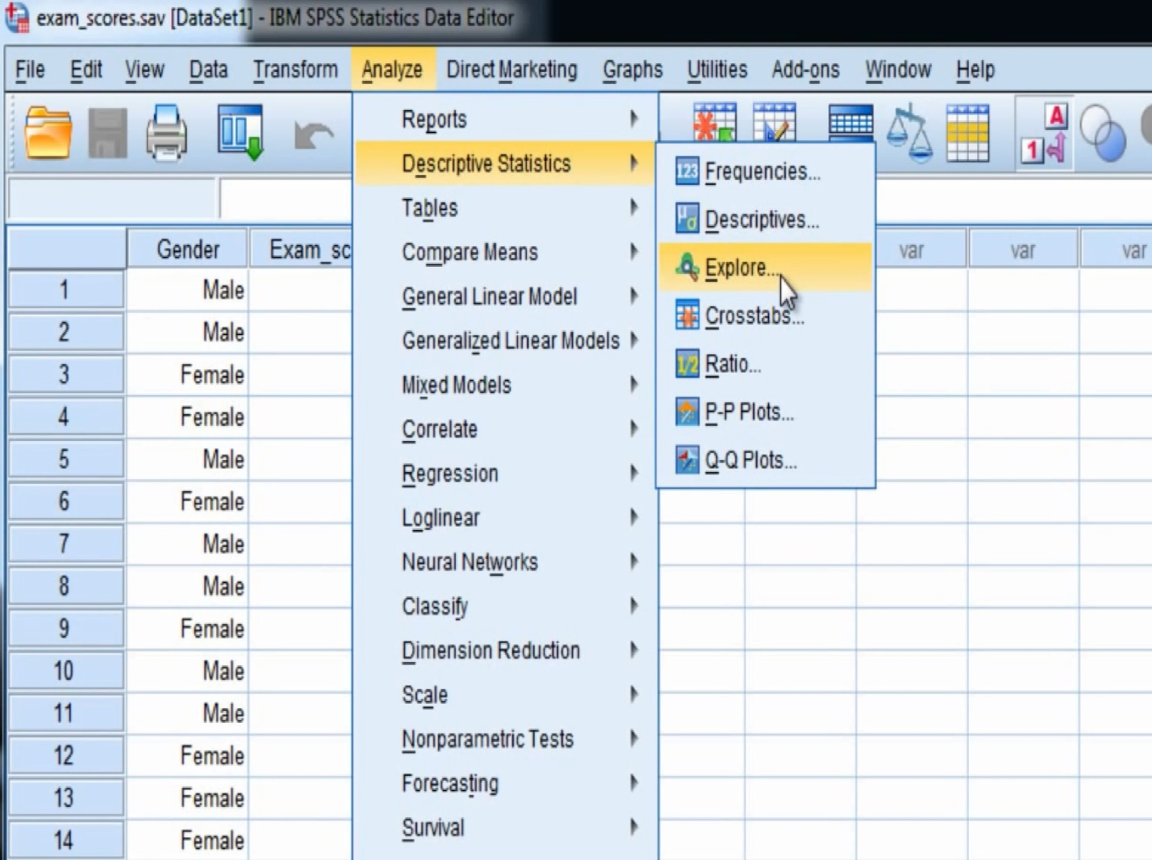
Testing for Skewness and Kurtosis
Skewness is a measure of symmetry, or the lack of symmetry. A distribution, or data set, is symmetric if it looks the same to the left and right of the center point.
Kurtosis is a measure of whether the data are peaked or flat relative to a normal distribution. Data sets with high kurtosis tend to have a distinct peak near the mean whereas low kurtosis tend to have a flat top near the mean.

Slide 10
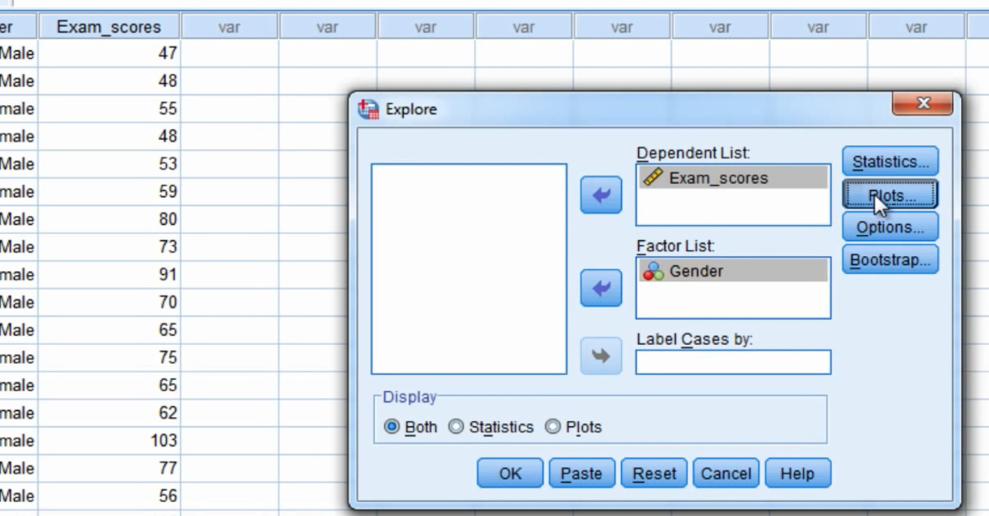
Testing for Skewness and Kurtosis

Slide 11
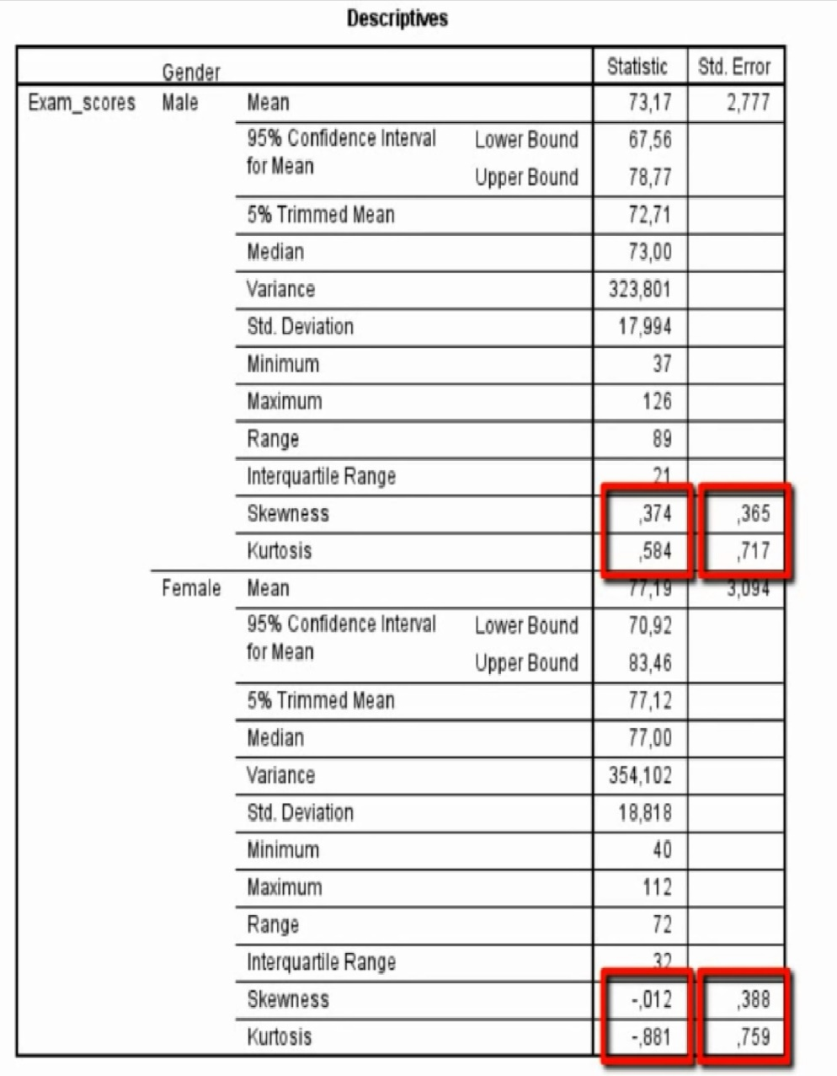
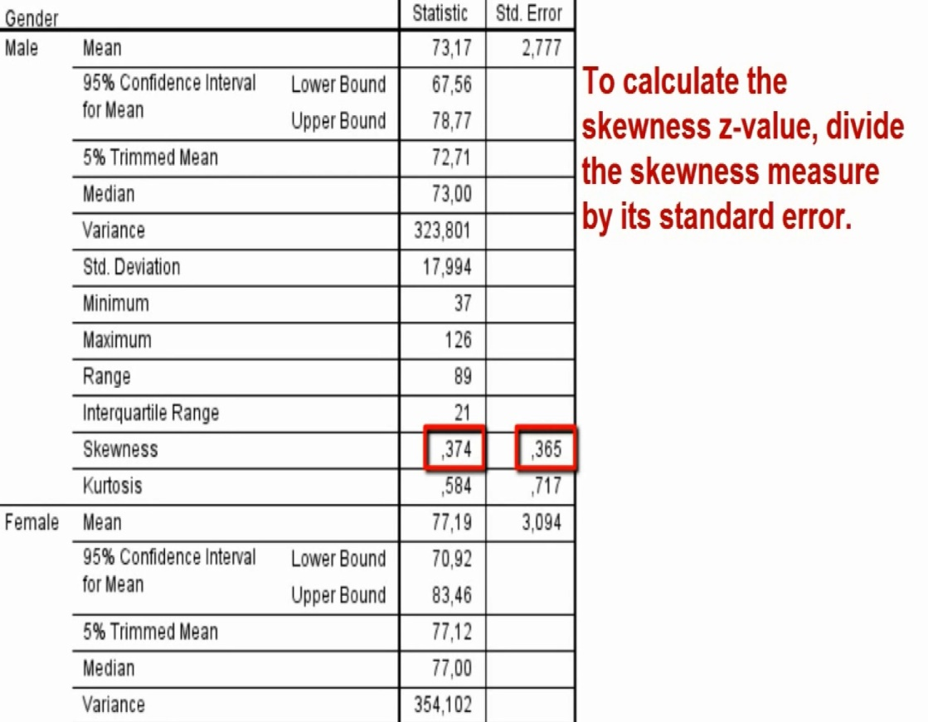
Checking the data: Skewness and Kurtosis

Slide 12
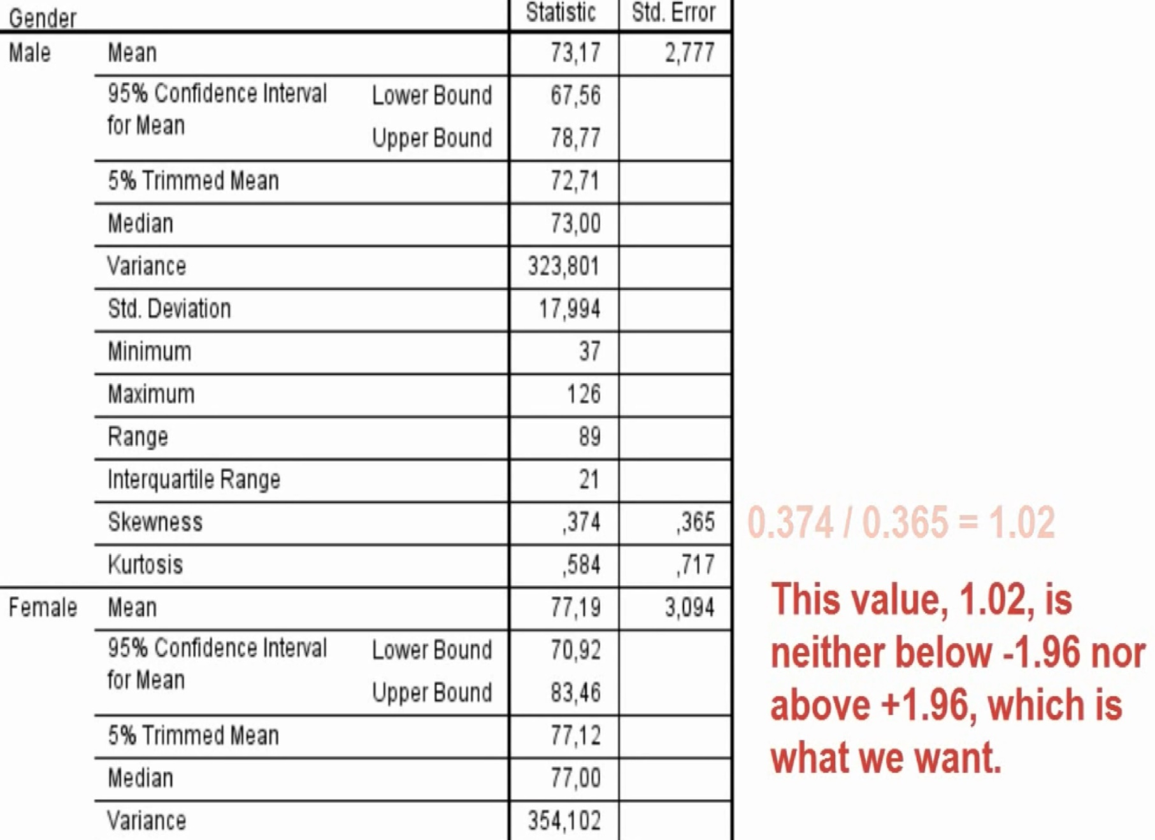
Checking the data: Skewness and Kurtosis

Slide 13
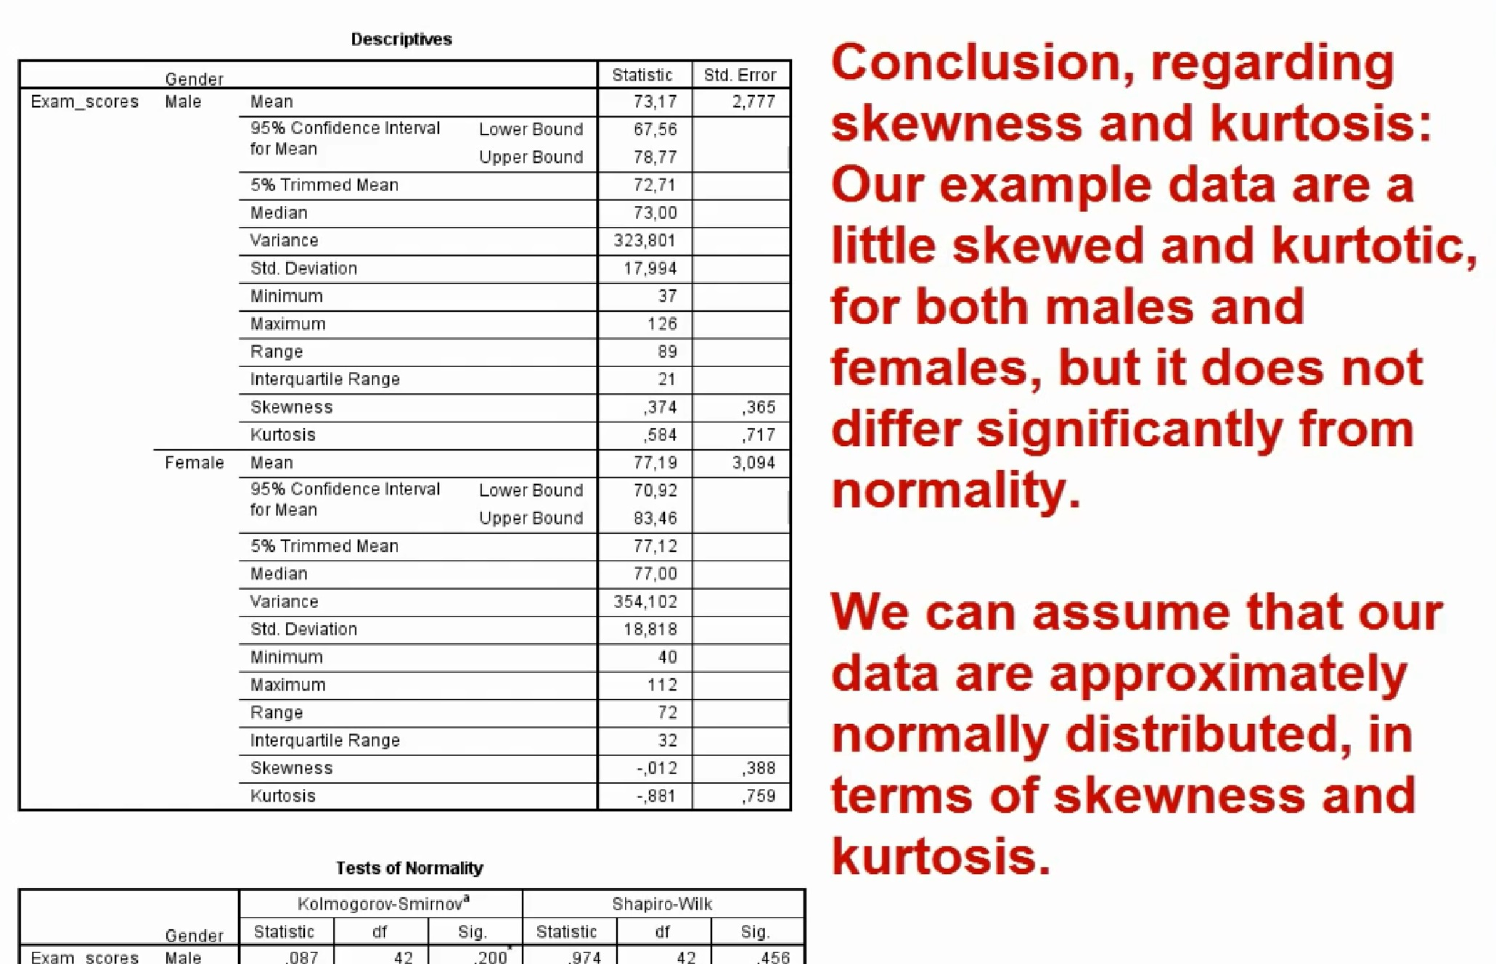
Checking the data: Skewness and Kurtosis

Slide 14
Checking the data: Kolmogorov–Smirnov test and Shapiro–Wilk test
Kolmogorov–Smirnov test and Shapiro–Wilk test: Compare the scores in the sample to a normally distributed set of scores with the same mean and standard deviation.
If the test is non-significant (p>.05) then it tells us that the distribution of the sample is not significantly different from the normal distribution (i.e. it is probably normal).
If the test is significant (p < .05) then the distribution is significantly different from a normal distribution.

Slide 15
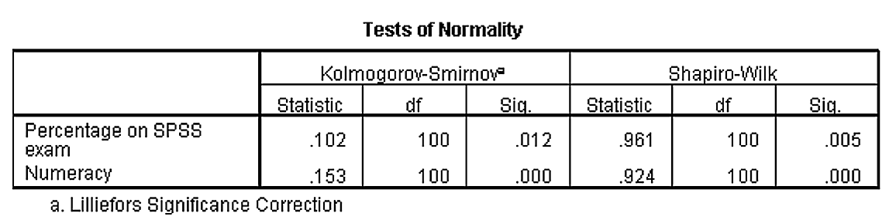
Tests of normality: Kolmogorov-Smirnov and Shapiro-Wilk tests
p-values
While reporting, also report these statistics in two decimal places
Check whether the p-value < or > .05

Slide 16
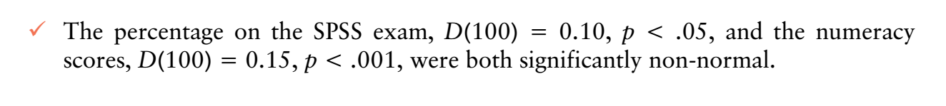
Reporting K-S test
The test statistic for the K–S test is denoted by D and you must also report the degrees of freedom (df) from the table in brackets after the D. See below on how to report:

Slide 17
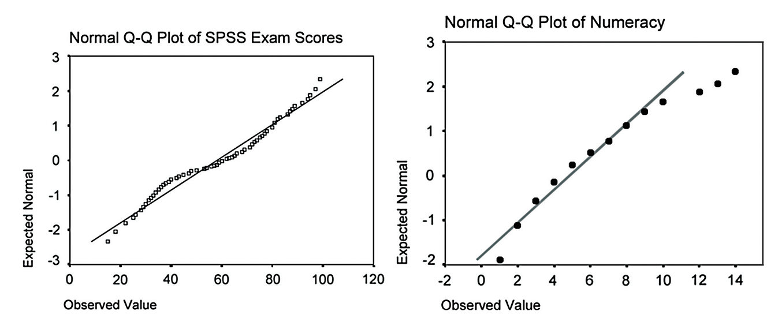
Using Q-Q plot to check normality of data

Slide 18
Levene’s test to check normality
if Levene’s test is significant at p ≤ .05 then we can conclude that the homogeneity of variances has been violated (which means the data you have is not normal) and that the variances are significantly different.
If, however, Levene’s test is non-significant (i.e. p > .05) then the variances of your data are roughly equal to the model so the data are not different from the model (which means data are normally distributed).

Slide 19
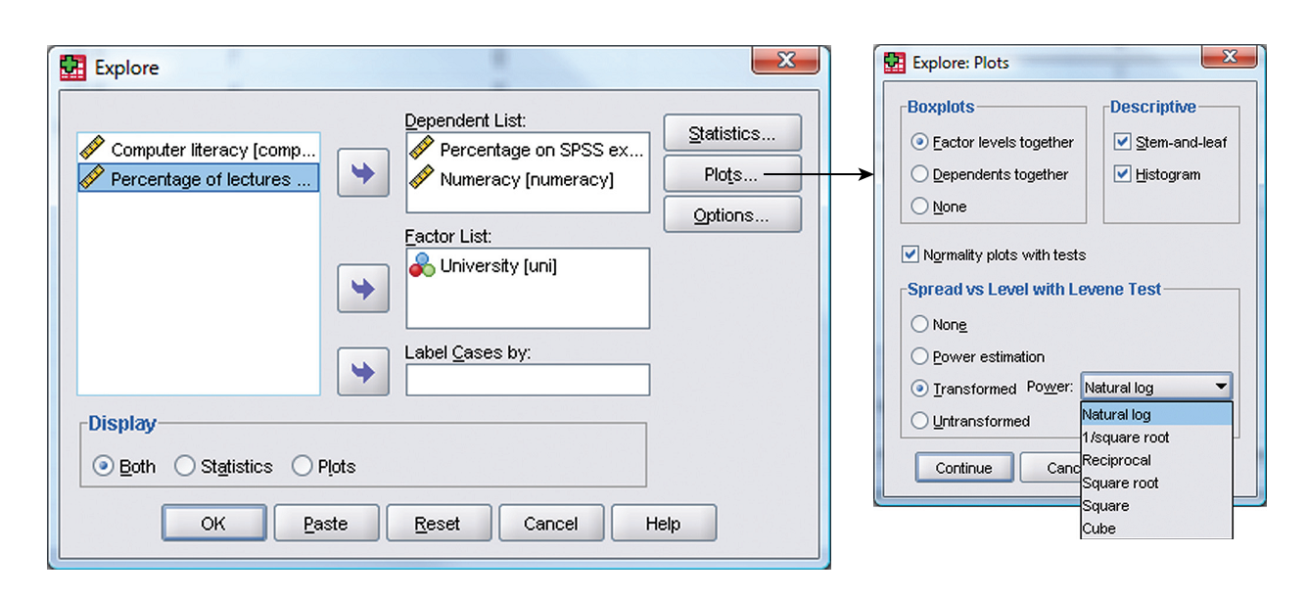
Levene’s Test

Slide 20
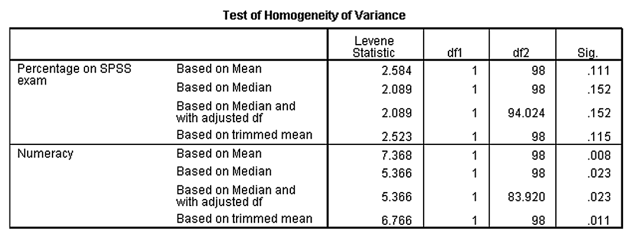
How to report Levene’s test?
Levene’s test can be denoted with the letter F and there are two different degrees of freedom. So you report in general form, as F(df1, df2) = value, sig.
Report like this: “For the percentage on the SPSS exam, the variances were equal for Duncetown and Sussex University students, F(1, 98) = 2.58, ns, but for numeracy scores the variances were significantly different in the two groups, F(1, 98) = 7.37, p < .01.”

